Slide 1
Neural fitted Q

Slide 2
Objectives
Generalization needs
Reinforcement Learning: sequential feedback, evaluative feedback, sampled feedback, tabular representation
The Cart-pole environment
Select the neural architecture
Select what to optimize
Select the exploration strategy
Select an optimization method
Neural Fitted Q (NFQ)
Challenges
Target Network
Experience Replay
Better exploration strategies
Deep Q-network (DQN)
Comparison

Slide 3
Generalization needs
In real tasks the state space is combinatorial and enormous
we cannot expect to find an optimal policy
the goal instead is to find a good approximate solution
The problem is the memory needed for large tables and the time needed to fill them accurately
in real tasks, almost every state encountered will never have been seen before
to make sensible decisions it is necessary to generalize from previous experience with different (but in some sense similar) states
How can experience with a limited subset of the state space be generalized to produce a good approximation over a much larger subset?
generalization from examples has been extensively studied in Machine Learning
we need to combine RL methods with existing generalization methods
The kind of generalization is called function approximation
takes examples from a desired function (e.g. value function)
attempts to generalize from them to construct an approximation of the entire function.

Slide 4
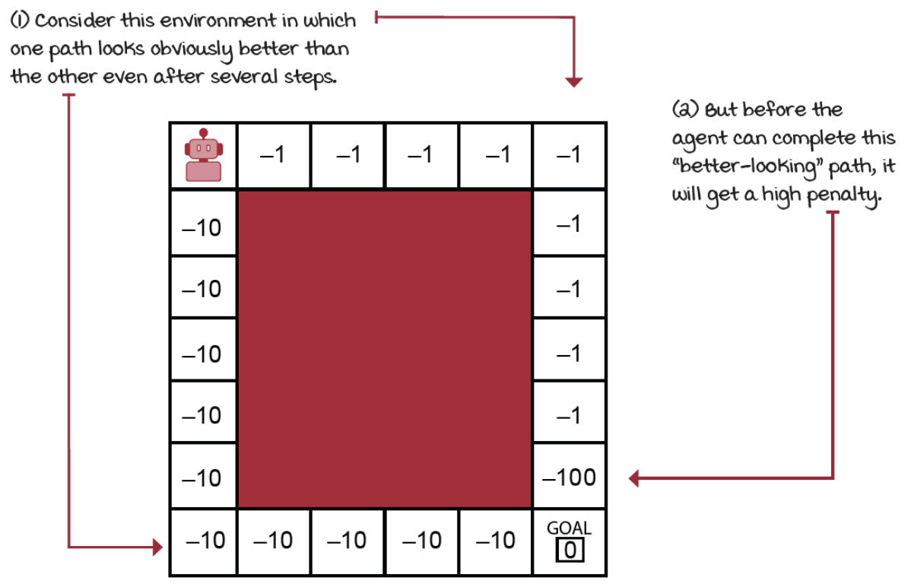

Challenges: sequential feedback
The Agent receives delayed feedback
chess: you make wrong moves early on, but consequences only manifest at the end
It is tricky to interpret the source of the feedback and rise the temporal credit assignment problem
determining which state-action pair is responsible for a reward
In supervised learning decisions don’t have long-term consequences.
classifying an image (correctly or not) has no bearing on future performance

Slide 5
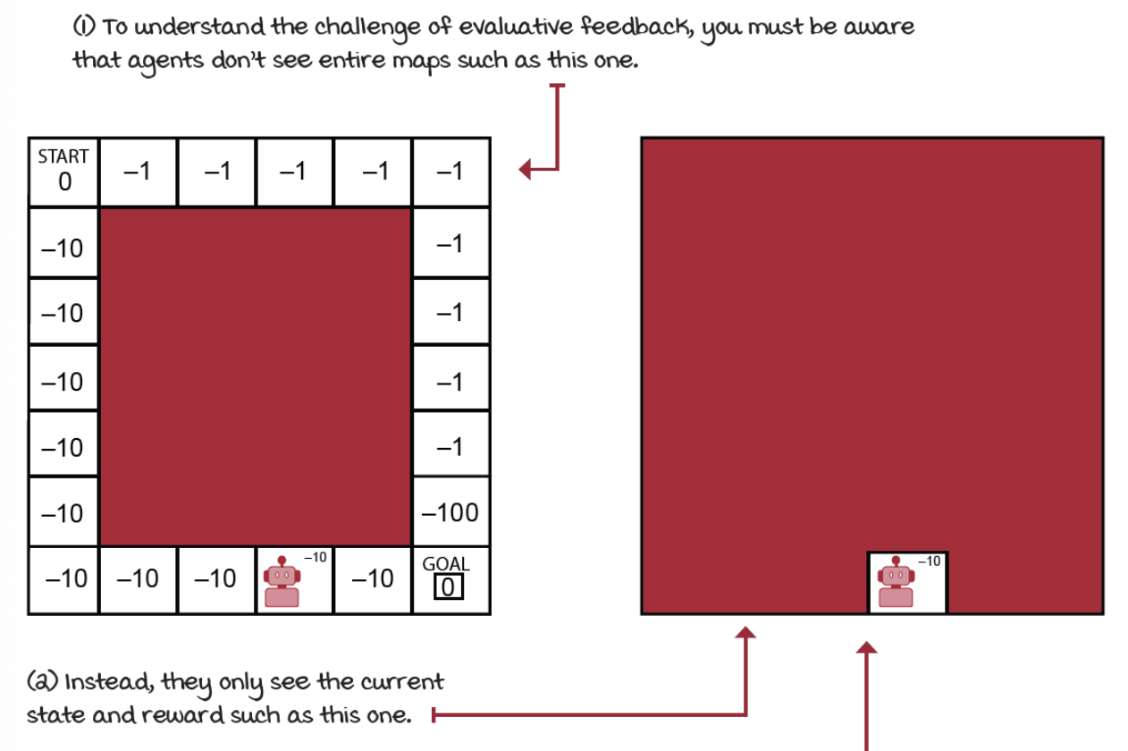

Challenges: evaluative feedback
The goodness of the feedback is only relative
the environment is uncertain
agent doesn’t know the actual dynamics of the environment
The agent must explore, but it misses capitalizing on its current knowledge
exploration-exploitation trade-off
The opposite is supervised feedback
In ML during learning, the model is given correct labels for each samples

Slide 6
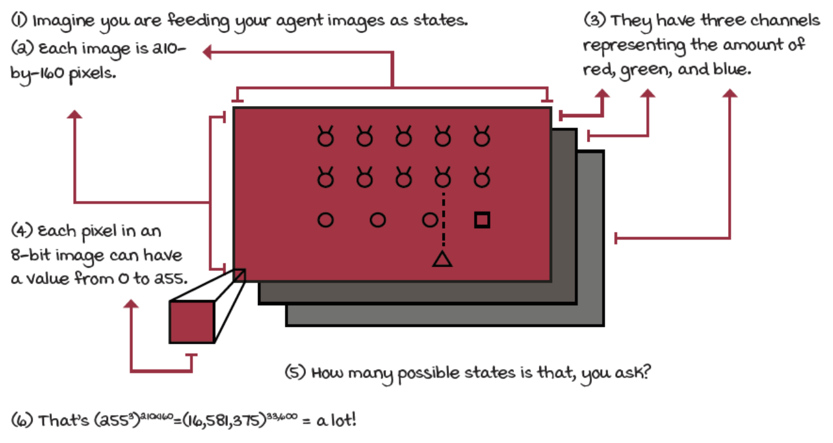
Challenges: sampled feedback
In real problems, agents are unlikely to sample all possible feedback exhaustively
common assumptions "sampling every state-action pair infinitely often” are reasonable in small grid worlds with finite state and action spaces
The core of supervised learning is to learn from sampled feedback in order to be able to generalize to new samples

Slide 7
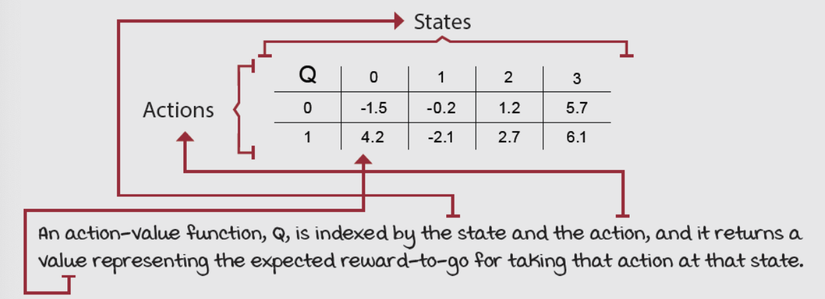
Challenges: tabular representation
The use of a table to represent value functions is no practical in complex problems
for example, Q-learning estimates the optimal action-value function by a matrix indexed by states and actions
Environments can have high-dimensional state spaces (the number of variables that comprise a single state is vast) or can additionally have continuous variables (a single variable can take on an infinite number of values)

Slide 8
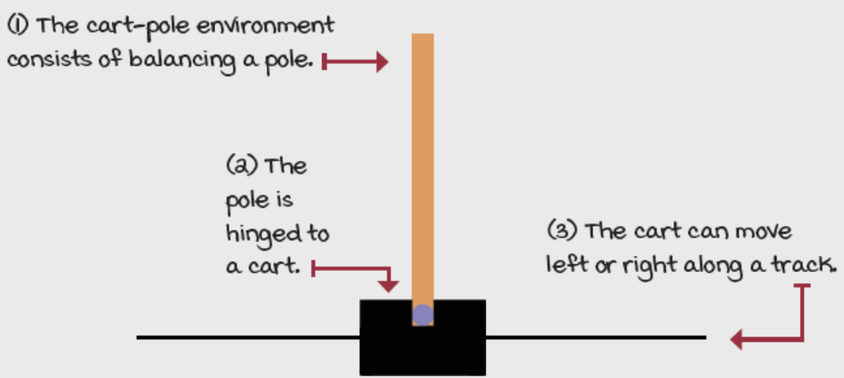
The Cart-pole environment
It is a classic in reinforcement learning
state space has four variables
position on the track (x-axis)
velocity along the track (x-axis)
angle
velocity at the tip
two available actions in every state
action 0 applies a –1 force to the cart (push it left)
action 1 applies a +1 force to the cart (push it right)
The cart reach a terminal state if the angle is more than 12 degrees away from the vertical position; the centre is more than 2.4 units from the centre of the track; and the episode count reaches 500 time steps.
The reward function is +1 for every time step
State space is low dimensional but continuous
Training is fast and function approximation can help

Slide 9
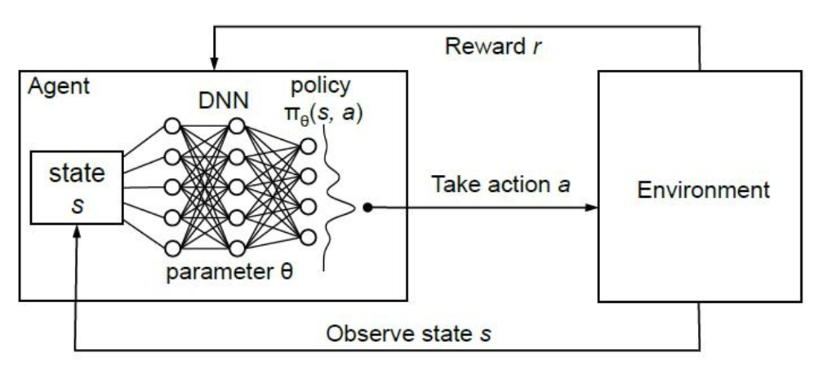
Select the neural architecture
Use a neural networks as a function approximation to approximate action-value function 𝑄(𝑠, 𝑎; 𝜃)
𝑄 estimate is parameterized by 𝜃 (the weights of a neural network), a state 𝑠 and an action 𝑎

Slide 10


Select what to optimize (1)
Loss function: a measure of how well our predictions are
MSE (mean squared error, or L2 loss)
average squared difference between the "predicted" and "true" values
straightforward in supervised learning (training/test set): in RL the "predicted values" are those from the neural network, but the "true values"?
We don’t have sample of that optimal values, but remember that
we can use the same principle of generalized policy iteration: alternate between policy-evaluation and policy-improvement
however, using non-linear approximation cannot guarantees convergence
We can use as "true values" the TD targets, which depend on a prediction also coming from the network, the value of the next state, in a circular dependency

Slide 11
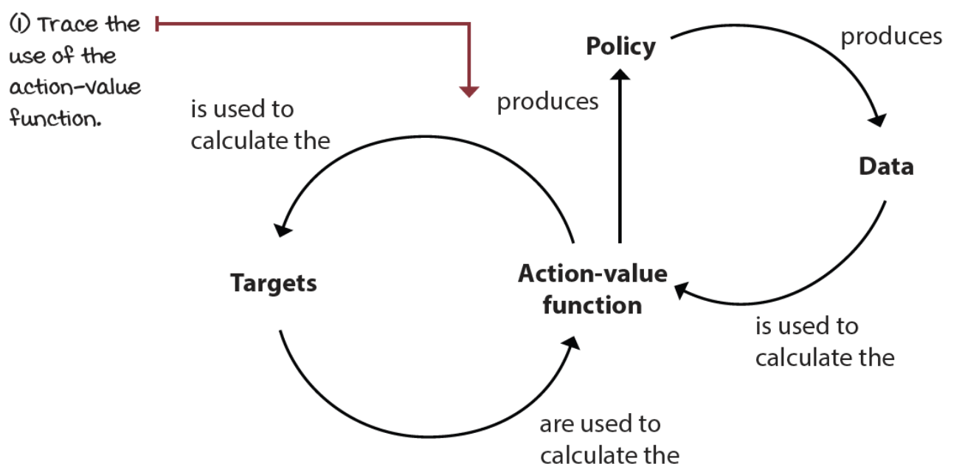
Select what to optimize (2)
This circular dependency is bad: it’s not well behaved because it doesn’t respect several of the assumptions made in supervised learning problems

Slide 12
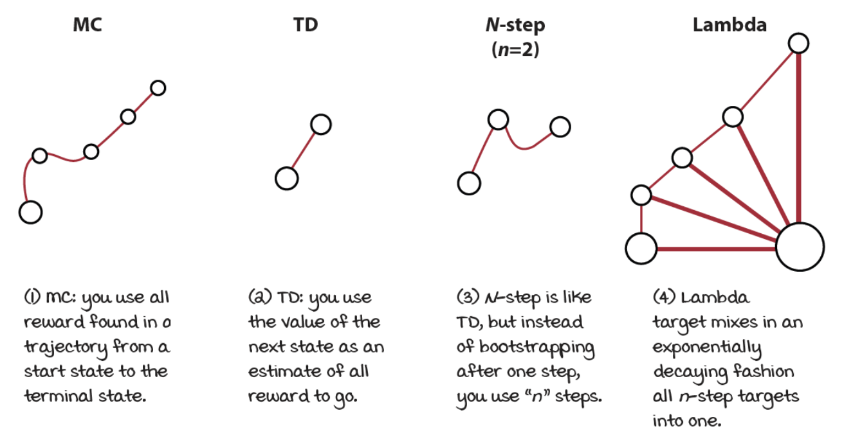
Select what to optimize (3)
There are multiple ways we can evaluate a policy:

Slide 13
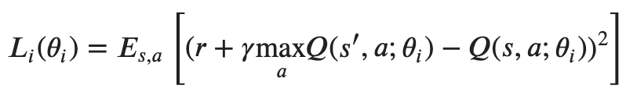
Select what to optimize (4)
We can use any of these targets and get solid results, however we keep things simple and use the off-policy TD target (Q-learning):
Now, we can substitute in the loss function definition:
Notice that in RL, the "true values" depend on predicted values themselves: they come from the model.

Slide 14
Select the exploration strategy
We need to balance the exploration-exploitation trade-off
almost any technique would work fine
to keep things simple, we’re going to use an epsilon-greedy strategy
Remember that the implication of the off-policy learning: two policies
a policy that generates behaviour (in this case is an epsilon-greedy policy)
a policy that we’re learning about
However, when evaluating the agent, we will use the action greedy with respect to the learned action-value function.

Slide 15
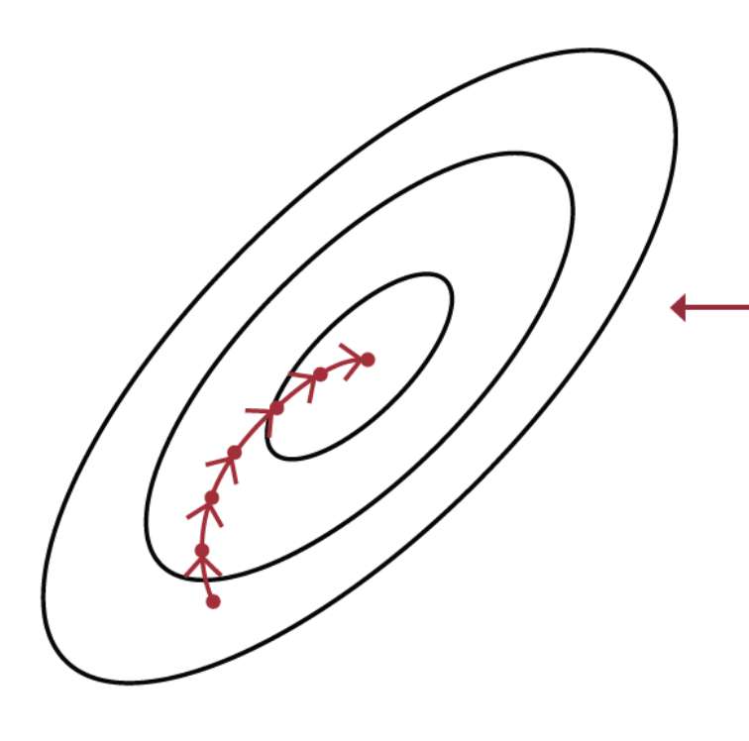
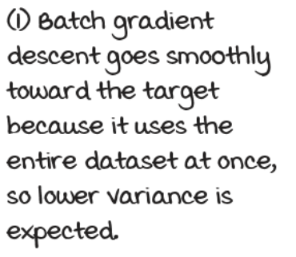
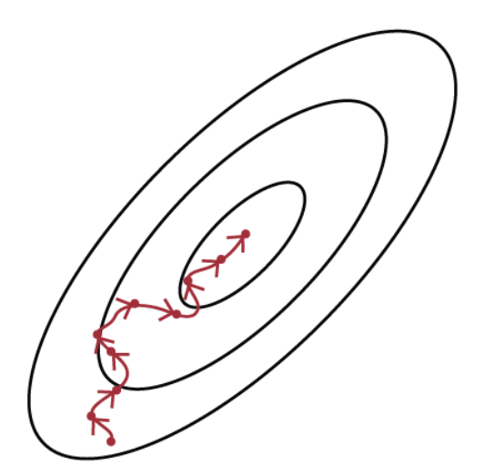
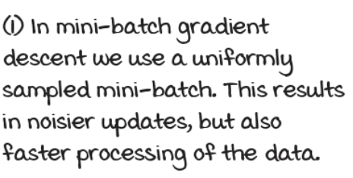
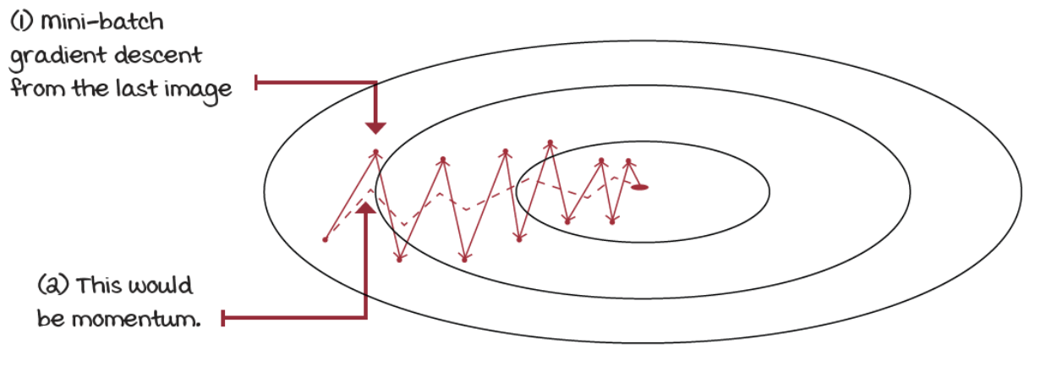
Select an optimization method
Gradient Descent method needs a couple of assumptions:
data must be independent and identically distributed (IID)
targets must be stationary
in RL we cannot ensure any of these assumptions
We need a more robust optimization method
Batch Gradient Descent:
takes the entire dataset, calculates the gradient and steps toward this gradient a little bit at a time
we don’t even have a dataset in advance, so it isn’t applicable
Mini-batch gradient descent
only a fraction of the data at a time (mini-batch)
Gradient descent with momentum
updates weights in the direction of the moving average of the gradients, instead of the gradient itself
Others: root mean square propagation (RMSprop), adaptive moment estimation (Adam)

Slide 16
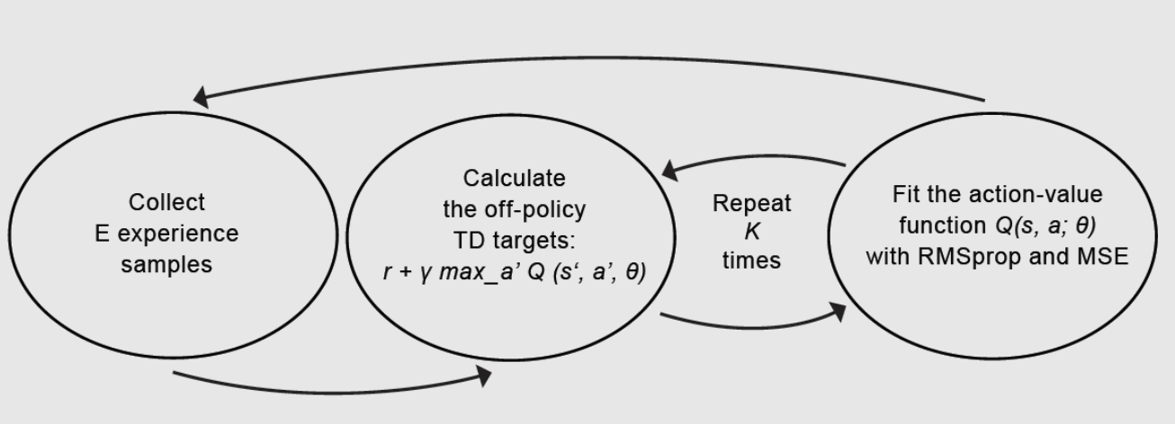
Neural Fitted Q (NFQ) (1)
Now we can put things together:
approximate 𝑄(𝑠,𝑎;𝜃) using a fully connected NN
use the off-policy TD targets (𝑟 + 𝛾 max_{𝑎}𝑄(𝑠′,𝑎;𝜃)) to evaluate policies;
use an epsilon-greedy strategy to improve policies;
use mean squared error (MSE) for the loss function;
and use RMSprop as optimizer
The full neural fitted Q-iteration (NFQ) algorithm has three main steps:

Slide 17
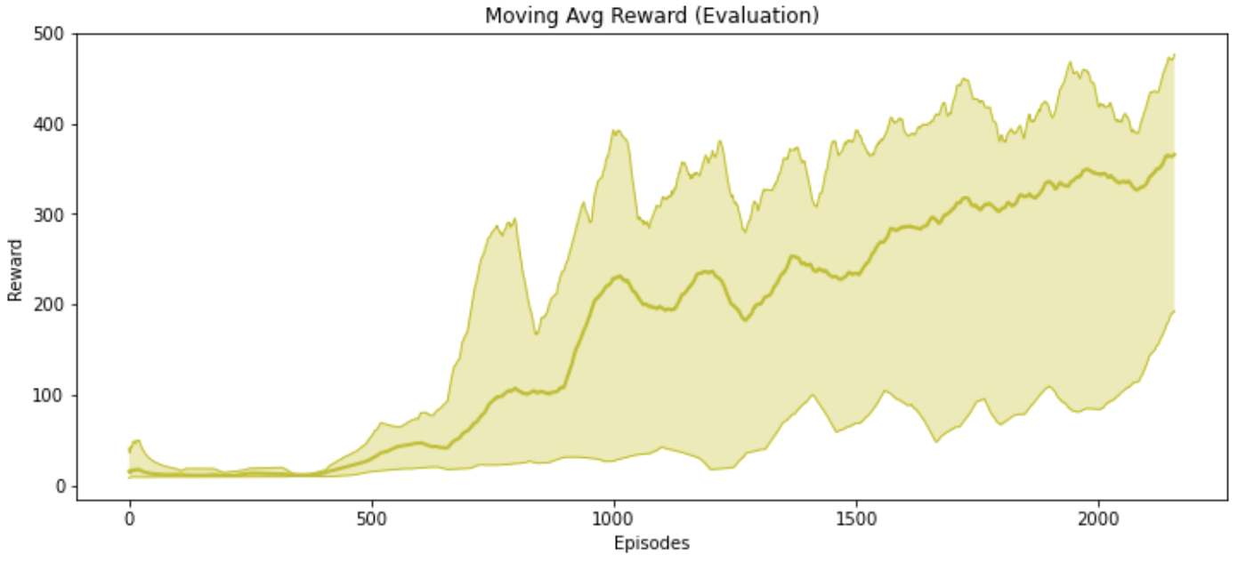
Neural Fitted Q (NFQ) (2)
NFQ is not a state-of-the-art solution, however in a simple environment as the cart-pole, it shows a decent performance
See “neural-fitted-q.ipynb”

Slide 18
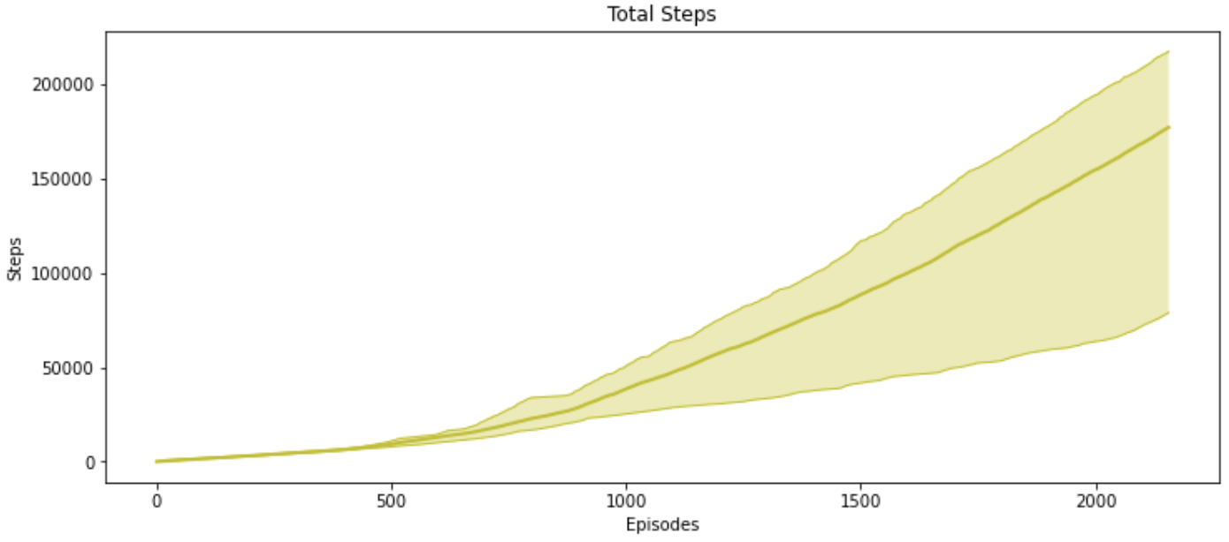
Neural Fitted Q (NFQ) (3)
The main issue with NFQ is that it takes too many steps to get decent performance
NFQ does poorly in terms of sample efficiency

Slide 19
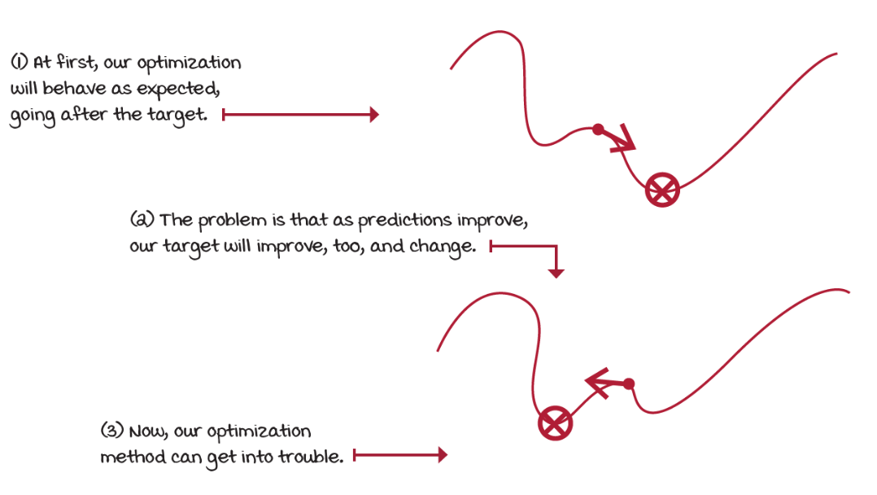
Challenges (1)
Notice that we’re using a non-stationary target for the learning updates
as we update the weights of the approximate Q-function, the targets also move and make our most recent update outdated.
Training becomes unstable quickly

Slide 20
Challenges (2)
We batched K experience samples, collected online, and update the NN from that mini-batch
these samples are correlated, they come from the same trajectory and policy
later we use different mini-batches that are also internally correlated, but likely different from previous mini-batches
This means that we aren’t holding the IID assumption,
optimization methods assume data samples independent and identically distributed
We’re training on almost the exact opposite
samples are not independent
the outcome of a new state is dependent on current state
samples aren’t identically distributed
underlying data generating process, the policy, is changing over time
optimization methods allow to relax the IID assumption to a certain degree, but we go all the way

Slide 21
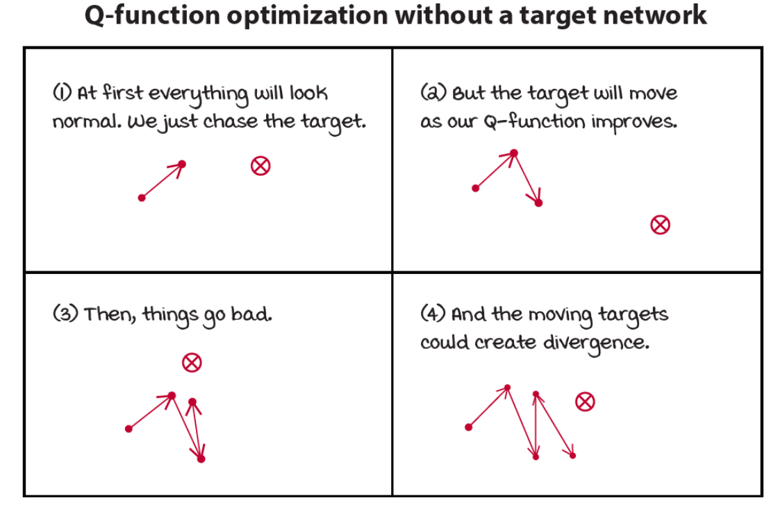
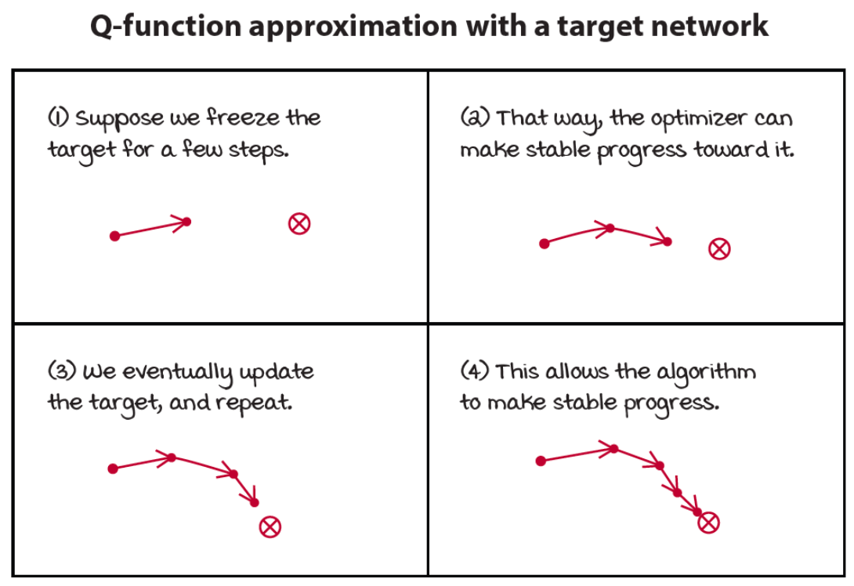
Target Network (1)
A way to make target values more stationary is to have a separate target network
We can fix it for multiple steps and reserve it for calculating more stationary targets

Slide 22
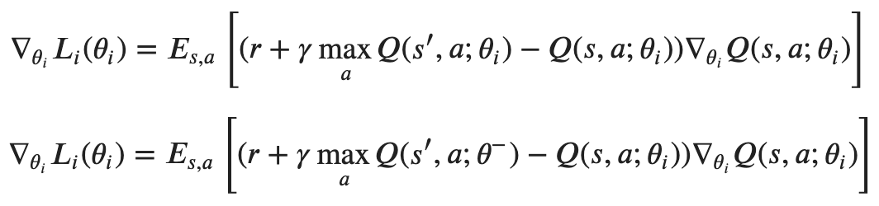
Target Network (2)
We create several small supervised learning problems presented sequentially to the agent
targets are fixed for as many steps as we fix our target network
substantially reduces the chance of divergenge
The only difference with NFQ is the age of the neural network weights
notice that we don’t have two different networks
target network is a previous instance of the network that we freeze
It’s essential to balance stability and speed by tuning this hyperparameter
the gradient update has time to catch up to the target: which is stable
we slow down learning because you’re no longer training on up-to-date values

Slide 23
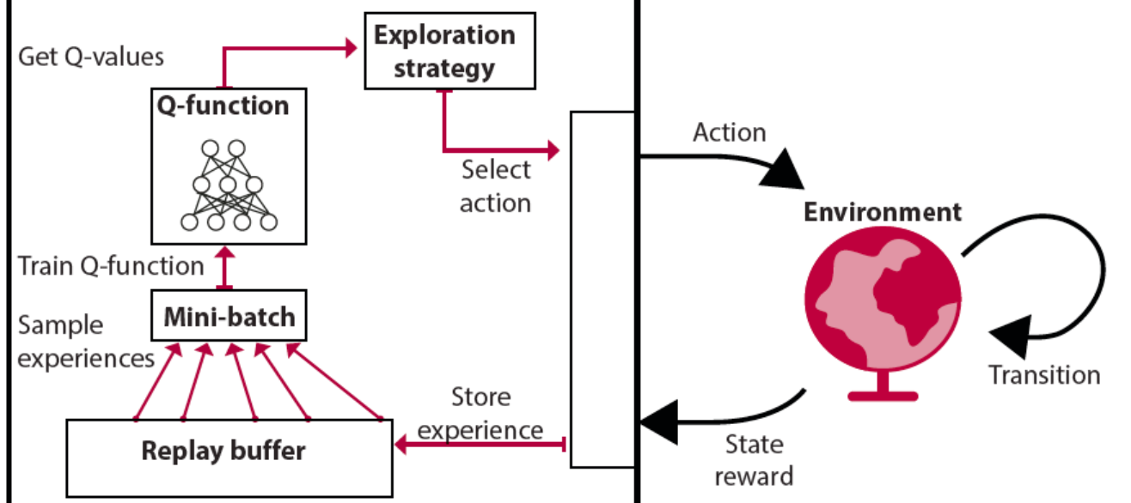
Experience Replay (1)
A data structure D to hold experience samples e_{𝑡}=(𝑆_{𝑡},𝐴_{𝑡},𝑅_{𝑡+1},𝑆_{𝑡+1}) for several steps
D=e₁,e₂,...,e_{𝑀} , 𝑀: size of the replay memory
If 𝑁<<𝑀, sampling of mini-batches comes from a broad set of past experiences
training can use more diverse mini-batch for performing updates
gives the impression data are IID (sampling from multiple trajectories)
agent no longer has to fit the model to the same mini-batch for multiple iterations

Slide 24
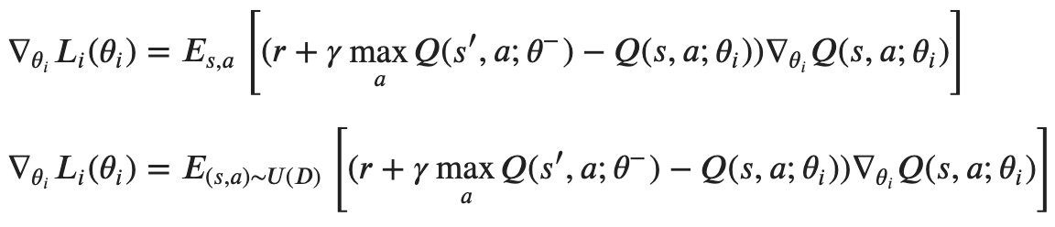
Experience Replay (2)
A sufficiently large replay memory yields a slow-moving target
lower risk of divergence
Unfortunately, implementation Is a challenge with high-dimensional observations
replay buffers hit a hardware memory limit quickly
e.g. image-based environments (each state representation is a stack of the latest image frames)
The difference with previous equation is that we’re now obtaining experiences by sampling D, instead of using the online experiences

Slide 25
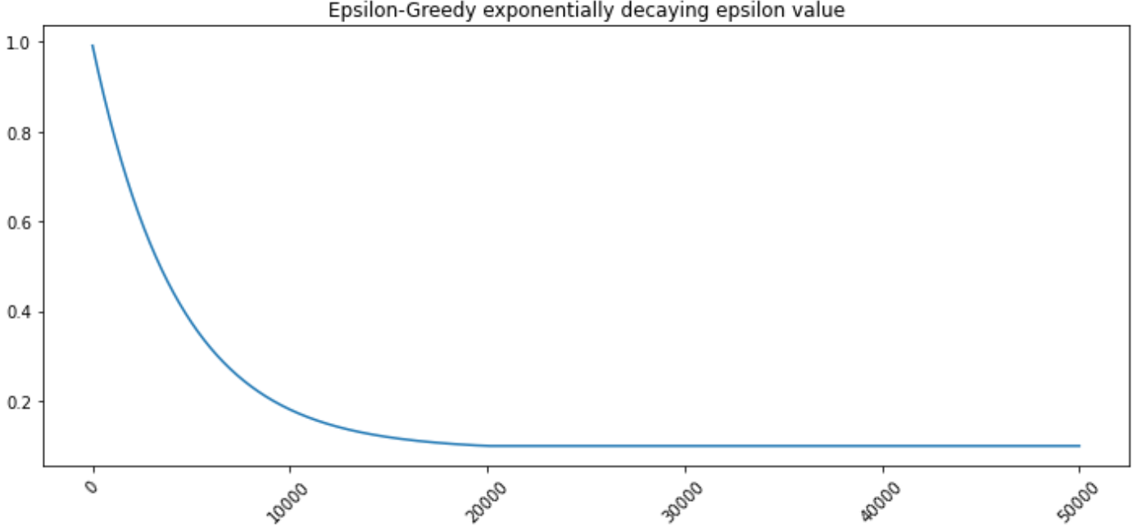
Better exploration strategies
Exploration is a vital component of RL
in NFQ, we use an epsilon-greedy exploration strategy
acting randomly with epsilon probability
However, this is not the only possible strategies to balance exploration and exploitation
exponentially decaying epsilon-greedy exploration strategy

Slide 26
Deep Q-network (DQN) (1)
One of the most popular deep RL algorithms and it started a series of research innovations that mark the history of RL
DQN claimed for the first time superhuman level performance on the Atari benchmark in which agents learned from raw pixel data from mere images
V. Mnih, et al. "Playing Atari with Deep Reinforcement Learning", NIPS 2013
The main difference with NFQ are
use an exponentially decaying epsilon-greedy strategy
use a replay buffer
use a target network
The algorithm has three main steps:
collect experience and insert it into the replay memory
randomly sample a mini-batch from the replay memory, and calculate the off-policy TD targets for the whole batch
fit the action-value function Q(s,a; θ) using MSE and RMSprop

Slide 27
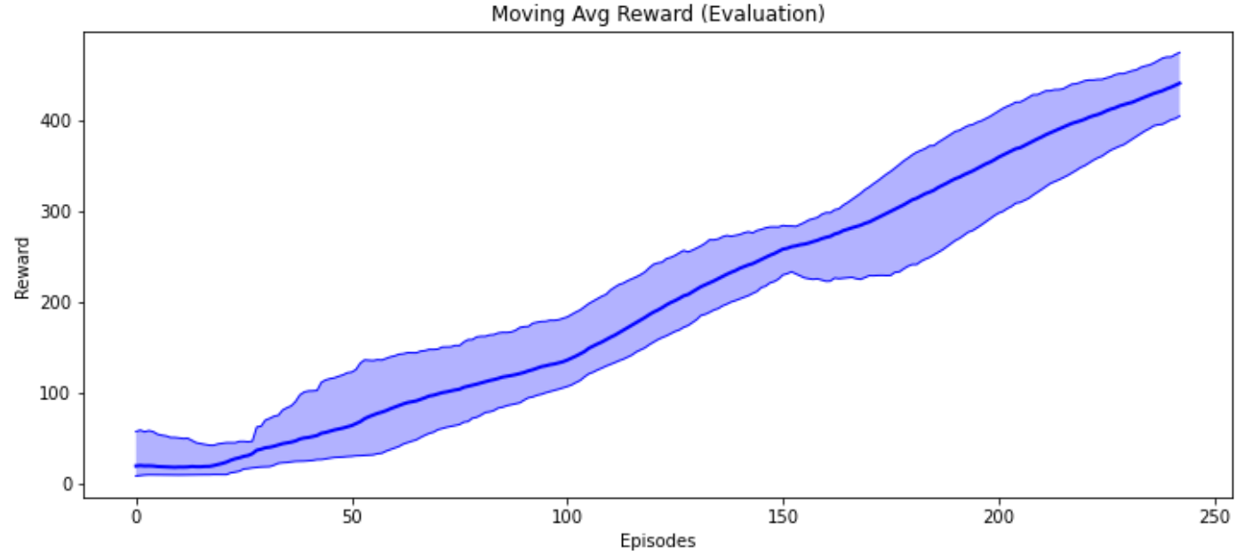
Deep Q-network (DQN) (2)
See “deep-q-network.ipynb”

Slide 28
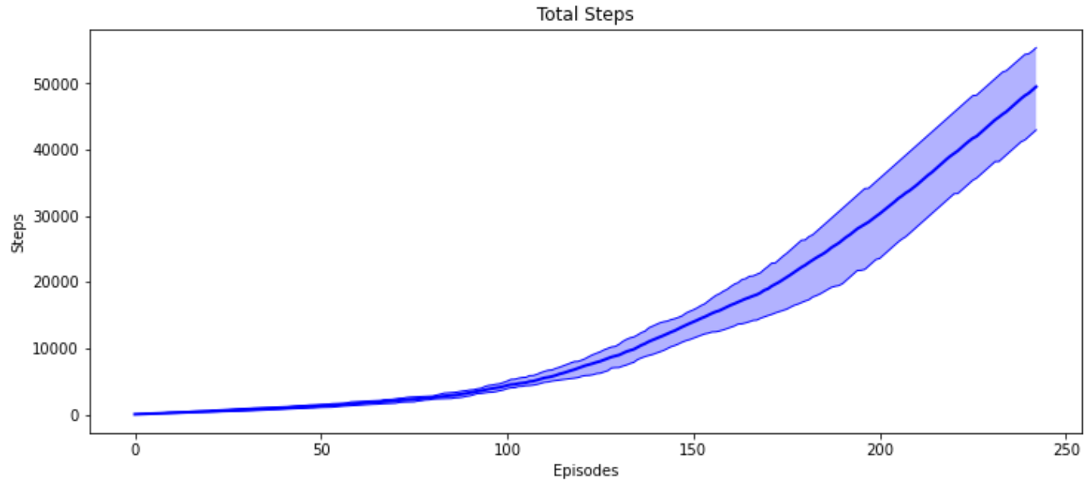
Deep Q-network (DQN) (3)

Slide 29
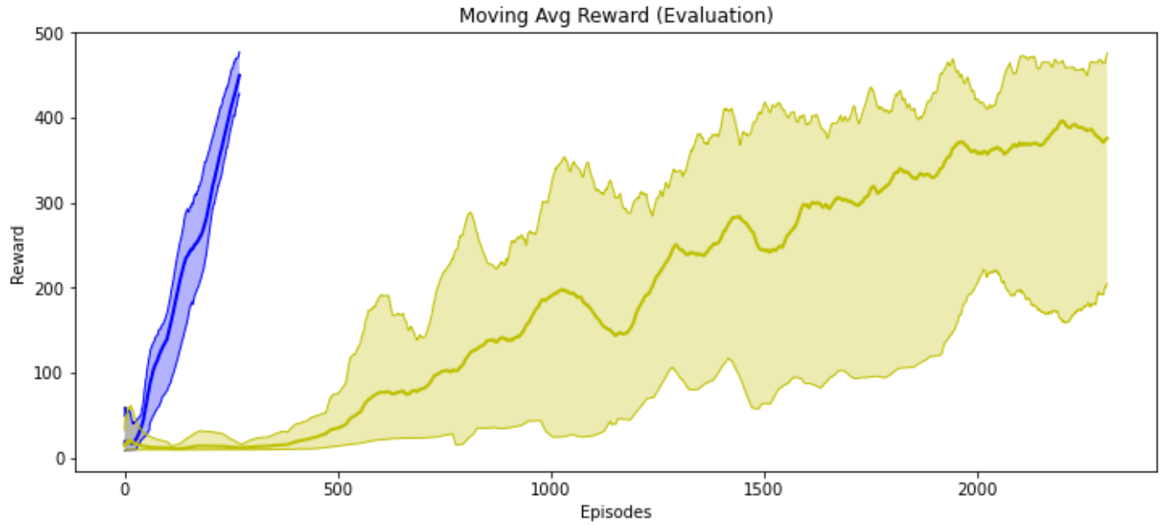
Comparison (1)
See “comparison.ipynb”
Both pass the cart-pole environment
DQN takes approximately 250 episodes while NFQ takes almost 2,500 episodes
DQN is more sample efficient than NFQ
Notice how NFQ is also noisier than DQN

Slide 30
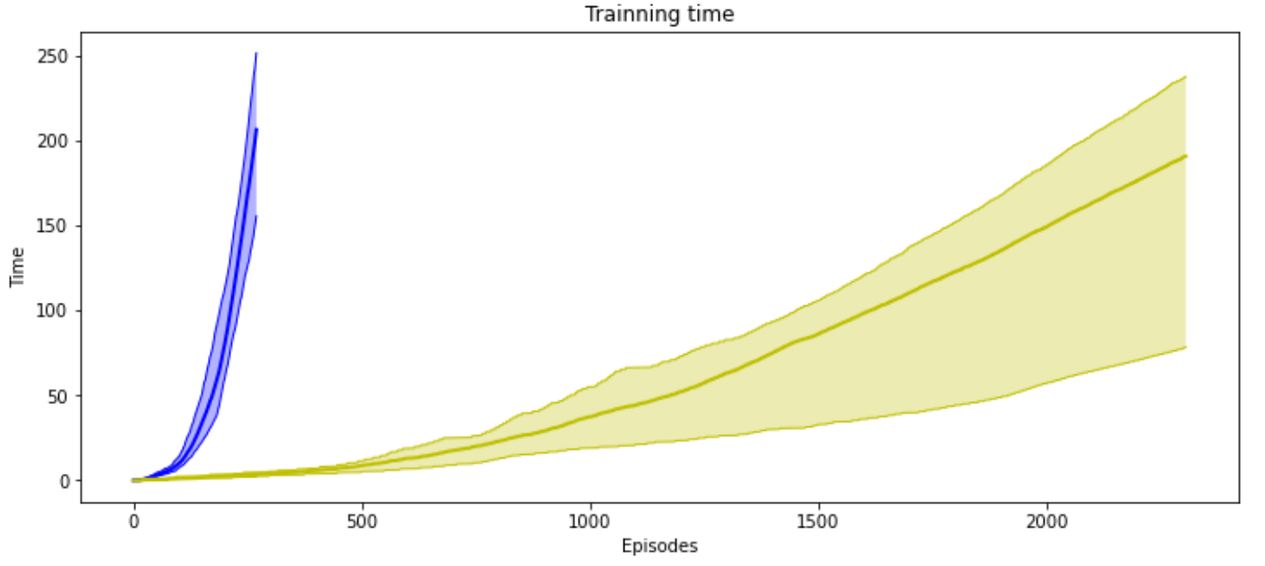
Comparison (2)
However, DQN takes more training time than NFQ to pass the environment.

Slide 31
More advanced approaches (1)
Double DQN (DDQN)
like Q-learning, DQN tends to overestimate
we’re taking the max of estimated values to estimate the max
a way to reduce positive bias is to have two instances of the action-value function
we can perform double learning with the other network we already have: the target network
Dueling DDQN
RL-aware neural network architecture
Prioritized Experience Replay (PER)
Instead of uniformly sampling reply memory, we draw samples that appear to provide the most information to the agent for actually making improvements
Challenges:
sensitive to hyperparameters
combination of bootstrapping, off-policy learning, and function approximators are known conjointly as the deadly triad
it is known to produce divergence

Slide 32
More advanced approaches (2)
We’ve explored methods that find optimal policies with the help of value functions
value-based methods
we learn value functions, however what we need are policies
Methods that optimize policies directly
policy-based methods
parameterize a policy and adjust it to maximize expected returns
REINFORCE, Vanilla Policy Gradient (VPG)
Methods that learn both policies and value functions
actor-critic methods
the policy (selects actions) can be seen as an actor and the value function (evaluates policies) can be seen as a critic
often perform better than value-based or policy-based methods alone
Deep Deterministic Policy Gradient (DDPG), Twin-Delayed DDPG (TD3), Doft Actor-Critic (SAC), Proxima Policy Optimization (PPO)

Slide 33
Exercise
1 - import the pendulum environment and show it with a random policy (hint: use the action space.sample() method of the environment)
2 - train a NFQ agent to solve the control problem
3 - show the learning curves
4 - show the policy behaviour
See “notebook – exercise-solution.ipynb”
5 – try other algorithms (e.g. DQN)

